Slide 1
جبر بول
Boolean Algebra

Slide 2
جبر بول
قوت اصلي سيستم هاي ديجيتال:
  جامعيت و قدرت فرمولاسيون رياضي جبر بول
مثال:
IF the lift door is closed
AND a button is pressed at a floor
THEN the lift must move
هر دو شرط:
the lift door is closed و
a button is pressed at a floor بايد true باشند تا آسانسور حرکت کند.

Slide 3
Digital Systems: Boolean Algebra and Logical Operations
In Boolean algebra:
  Values: 0,1
  0: if a logic statement is false,
  1: if a logic statement is true.
Operators: AND, OR, NOT

Slide 4
مثال
IF the lift door is closed
AND a button is pressed at a floor
THEN the lift must move
door closed?
button pressed?
move lift?
false/0
false/0
true/1
true/1
false/0
true/1
false/0
true/1
false/0
false/0
false/0
TRUE/1

Slide 5
سيستم هاي نوعي
System
ورودي ها:
  فشار کليد (ديجيتال)
  درجةحرارت محيط (آنالوگ)
  تغييرات سطح مايع (آنالوگ)
خروجي ها:
  ولتاژ راه اندازي موتور (آنالوگ)
  بازکردن/بستن شير (آنالوگ يا ديجيتال)
  نمايش روي LCD (ديجيتال)

Slide 6
سيستم هاي نوعي
Analog Phenomena
Sensors & other inputs
System
Analog Inputs
ورودي ها:
  فشار کليد (ديجيتال)
  درجةحرارت محيط (آنالوگ)
  تغييرات سطح مايع (آنالوگ)
خروجي ها:
  ولتاژ راه اندازي موتور (آنالوگ)
  بازکردن/بستن شير (آنالوگ يا ديجيتال)
  نمايش روي LCD (ديجيتال)
Digital Inputs
A2D
Digital Inputs
Digital System
Digital Outputs
Digital Outputs
D2A
Actuators and Other Outputs

Slide 7

مثال: دستگاه اطفاي حريق خودکار
Analog Phenomena
Sensors & other inputs
System
Analog Inputs
Digital Inputs
A2D
Digital Inputs
رفتار سيستم:
  اگر درجة حرارت محيط از مقدار مشخصي بيشتر است و کليد فعال سازي دستگاه روشن است، شير آب را باز کن.
Digital System
Digital Outputs
Digital Outputs
D2A
Actuators and Other Outputs

Slide 8

مثال: چراغ هشدار کمربند ايمني
Analog Phenomena
Sensors & other inputs
Analog Inputs
Digital Inputs
A2D
Digital Inputs
Digital System
  S = ‘1’: کمربند بسته است.
  K = ‘1’: سوييچ داخل است.
  P = ‘1’: راننده روي صندلي است.
Digital Outputs
Digital Outputs
D2A
Actuators and Other Outputs

Slide 9
سوييچ ها: عملگرهاي منطقي
IF the lift door is closed
AND a button is pressed at a floor
AND “Open” button is off
THEN the lift must move
Door
closed
Button
pressed
Open
off
T
Move lift
rue
Open button

Slide 10
سوييچ ها: عملگرهاي منطقي
IF the lift door is closed
AND a button is pressed at a floor
AND “Open” button is off
THEN the lift must move
Door
closed
Button
pressed
Open
off
T
Move lift
rue
Open button
Button
at a floor
Open
Is off
Door
closed
IF ((a button pressed at a floor
AND “Open” button is off)
OR a button inside the lift is pressed)
AND the door lift is closed
THEN the lift can move
True
Move lift
True
Button
inside

Slide 11
Binary Logic
  Deals with binary variables that take 2 discrete values (0 and 1), and with logic operations
  Basic logic operations:
    AND, OR, NOT
  Binary/logic variables: letters: A,B,C,…,X,Y,Z

Slide 12
Binary Logic Function
F(vars) = expression
Example:
F(a,b) = a’•b + b’
G(x,y,z) = x•(y+z’)
Operators ( +, •, ‘ )
Variables
Constants ( 0, 1 )
Groupings (parenthesis)
set of binary
variables

Slide 13
Basic Logic Operators
  AND (also •, )
  OR (also +, )
  NOT (also ’, )
  F(a,b) = a•b, reads F is 1 if and only if a=b=1
  G(a,b) = a+b, reads G is 1 if either a=1 or b=1 or both
  H(a) = a’, reads H is 1 if a=0
Binary
Unary

Slide 14
Basic Logic Operators (cont.)
1-bit logic AND resembles binary multiplication:
  0 • 0 = 0, 0 • 1 = 0,
  1 • 0 = 0, 1 • 1 = 1
1-bit logic OR resembles binary addition, except for one operation:
  0 + 0 = 0, 0 + 1 = 1,
  1 + 0 = 1, 1 + 1 = 1 (≠ 10₂)

Slide 15
Truth Tables for logic operators
Truth table:
tabular form that uniquely represents the relationship between the input variables of a function and its output
2-Input AND
2-Input OR
NOT
A | B | F=A•B
0 | 0 | 0
0 | 1 | 0
1 | 0 | 0
1 | 1 | 1
A | B | F=A+B
0 | 0 | 0
0 | 1 | 1
1 | 0 | 1
1 | 1 | 1
A | F=A’
0 | 1
1 | 0

Slide 16
Truth Tables (cont.)
Q:
  Let a function F() depend on n variables. How many rows are there in the truth table of F() ?

Slide 17
Truth Tables (cont.)
Q:
  Let a function F() depend on n variables. How many rows are there in the truth table of F() ?
A:
  2^{n} rows, since there are 2^{n} possible binary patterns/combinations for the n variables

Slide 18
Logic Gates
  Logic gates are abstractions of electronic circuit components that operate on one or more input signals to produce an output signal.
2-Input AND
2-Input OR
NOT (Inverter)
A
A
F
G
A
H
B
B
H = A’
F = A•B
G = A+B

Slide 19
Timing Diagram
t₀
t₁
t₂
t₃
t₄
t₅
t₆
A
1
Input
signals
0
1
Transitions
B
0
F=A•B
1
0
Basic
Assumption:
Zero time for
signals to
propagate
Through gates
Gate
Output
Signals
G=A+B
1
0
H=A’
1
0

Slide 20
The Real World
  Physical electronic components are continuous, not discrete!
    Transition from logic 1 to logic 0 does not take place instantaneously in real digital systems
  These are the building blocks of all digital components!
  Intermediate values may be visible for an instant
  Boolean algebra useful for describing the steady state behavior of digital systems
  Be aware of the dynamic, time varying behavior too!
Time

Slide 21
Circuit that implements logical negation (NOT)
Logic 0 Input
+5
Voltage
Inverter behavior as a function of input voltage
input ramps from 0V to 5V
output holds at 5V for some range of small input voltages
then changes rapidly, but not instantaneously!
V
Out
Logic 1 Input
Voltage
0
V
+5
In

Slide 22
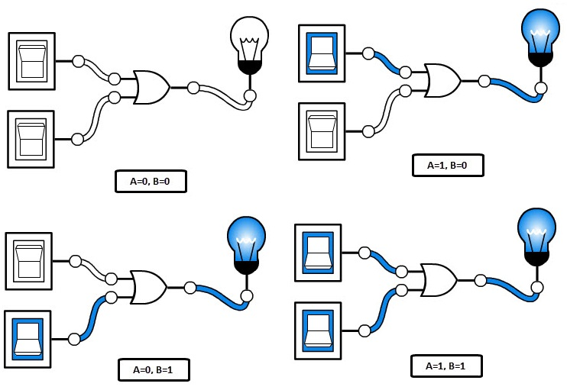
Logic Gates
Steady state matters in Boolean algebra

Slide 23

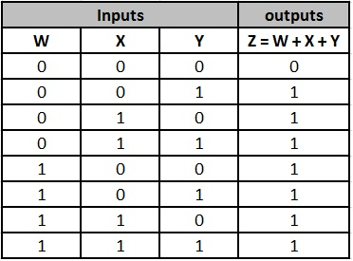
Three-Input Gates

Slide 24
Combinational Logic Circuit from Logic Function
Combinational Circuit Design:
F = A’ + B•C’ + A’•B’
  connect input signals and logic gates:
    Circuit input signals → from function variables (A, B, C)
    Circuit output signal → function output (F)
    Logic gates → from logic operations

Slide 25
Combinational Logic Circuit from Logic Function
Combinational Circuit Design:
F = A’ + B•C’ + A’•B’
  connect input signals and logic gates:
    Circuit input signals → from function variables (A, B, C)
    Circuit output signal → function output (F)
    Logic gates → from logic operations
C
A
F
B

Slide 26
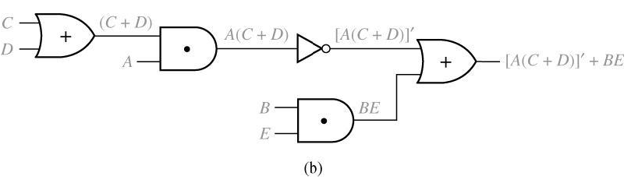
Logic Evaluation
Circuit of logic gates :
Logic Expression :

Slide 27
Logic Evaluation
Circuit of logic gates :
Logic Expression :

Slide 28
Logic Evaluation
Circuit of logic gates :
Logic Expression :
Logic Evaluation : A=B=C=1, D=E=0

Slide 29
Logic Evaluation
Circuit of logic gates :
Logic Expression :
Logic Evaluation : A=B=C=1, D=E=0

Slide 30
Logic Evaluation
Logic Evaluation : A=B=C=1, D=E=0

Slide 31
Combinational Logic Optimization
  In order to design a cost-effective and efficient circuit, we must minimize
    the circuit’s size
      area
    propagation delay
      time required for an input signal change to be observed correctly at the output line

Slide 32
Combinational Logic Optimization
  In order to design a cost-effective and efficient circuit, we must minimize
    the circuit’s size
      area
    propagation delay
      time required for an input signal change to be observed correctly at the output line
  Observe the truth table of
    F = A’ + B•C’ + A’•B’
    G = A’ + B•C’
  are identical → same function
  Use G to implement the logic circuit
    less components
A | B | C | F | G
0 | 0 | 0 | 1 | 1
0 | 0 | 1 | 1 | 1
0 | 1 | 0 | 1 | 1
0 | 1 | 1 | 1 | 1
1 | 0 | 0 | 0 | 0
1 | 0 | 1 | 0 | 0
1 | 1 | 0 | 1 | 1
1 | 1 | 1 | 0 | 0

Slide 33
Proof Using Truth Table
n variable needs rows
n times
A B C |  | B’ | AB’ | AB’ + C |  | A + C | B’ + C | (A + C) (B’ + C)
0 0 0 0 0 1 0 1 0 0 1 1 1 0 0 1 0 1 1 1 0 1 1 1 |  | 1 1 0 0 1 1 0 0 | 0 0 0 0 1 1 0 0 | 0 1 0 1 1 1 0 1 |  | 0 1 0 1 1 1 1 1 | 1 1 0 1 1 1 0 1 | 0 1 0 1 1 1 0 1

Slide 34
Combinational Logic Optimization
C
    F=A’ + B•C’ + A’•B’
A
F
B
C
    G=A’ + B•C’
B
A
G

Slide 35
Boolean Algebra
  VERY nice machinery used to manipulate (simplify) Boolean functions
  George Boole (1815-1864): “An investigation of the laws of thought”
  Terminology:
    Literal: A variable or its complement
      A, B’, x’
    Product term: literals connected by •
      X.Y
      A.B’.C.D,
    Sum term: literals connected by +
      A+B’
      A’+B’+C

Slide 36
Boolean Algebra Properties
Let X: boolean variable,
0,1: constants
  X + 0 = X -- Zero Axiom
  X • 1 = X -- Unit Axiom
  X + 1 = 1 -- Unit Property
  X • 0 = 0 -- Zero Property
A | B | F=A+B
0 | 0 | 0
0 | 1 | 1
1 | 0 | 1
1 | 1 | 1
A | B | F=A•B
0 | 0 | 0
0 | 1 | 0
1 | 0 | 0
1 | 1 | 1
Example:

Slide 37
Boolean Algebra Properties (cont.)
A | B | F=A+B
0 | 0 | 0
0 | 1 | 1
1 | 0 | 1
1 | 1 | 1
Let X: boolean variable,
0,1: constants
  X + X = X -- Idempotent
  X • X = X -- Idempotent
  X + X’ = 1 -- Complement
  X • X’ = 0 -- Complement
  (X’)’ = X -- Involution
A | B | F=A•B
0 | 0 | 0
0 | 1 | 0
1 | 0 | 0
1 | 1 | 1
Example:

Slide 38
The Duality Principle
  The dual of an expression is obtained by exchanging (• and +), and (1 and 0) in it,
    provided that the precedence of operations is not changed.
  Do not exchange x with x’
  Example:
    Find H(x,y,z), the dual of F(x,y,z) = x’yz’ + x’y’z

Slide 39
The Duality Principle
  The dual of an expression is obtained by exchanging (• and +), and (1 and 0) in it,
    provided that the precedence of operations is not changed.
  Do not exchange x with x’
  Example:
    Find H(x,y,z), the dual of F(x,y,z) = x’yz’ + x’y’z
    H = (x’+y+z’) (x’+y’+ z)
  Dual does not always equal the original expression
If a Boolean equation is valid, its dual is also valid

Slide 40
The Duality Principle (cont.)
  With respect to duality, Identities 1 – 8 have the following relationship:
1. X + 0 = X 2. X • 1 = X (dual of 1)
3. X + 1 = 1 4. X • 0 = 0 (dual of 3)
5. X + X = X 6. X • X = X (dual of 5)
7. X + X’ = 1 8. X • X’ = 0 (dual of 8)

Slide 41
More Boolean Algebra Properties
Let X,Y, and Z: boolean variables
10. X + Y = Y + X 11. X • Y = Y • X -- Commutative
12. X + (Y+Z) = (X+Y) + Z 13. X•(Y•Z) = (X•Y)•Z -- Associative
14. X•(Y+Z) = X•Y + X•Z 15. X+(Y•Z) = (X+Y) • (X+Z)
-- Distributive
16. (X + Y)’ = X’ • Y’ 17. (X • Y)’ = X’ + Y’ -- DeMorgan’s
In general,
( X₁ + X₂ + … + X_{n} )’ = X₁’•X₂’ • … •X_{n}’
( X₁•X₂•… •X_{n} )’ = X₁’ + X₂’ + … + X_{n}’

Slide 42
Associative Laws for AND
B
A
C
=
B
A
C
A(BC)=ABC

Slide 43
Proof of Associative Law
Associative Laws:
Proof of Associative Law for AND
X Y Z |  | XY YZ | (XY)Z X(YZ)
0 0 0 0 0 1 0 1 0 0 1 1 1 0 0 1 0 1 1 1 0 1 1 1 |  | 0 0 0 0 0 0 0 1 0 0 0 0 1 0 1 1 | 0 0 0 0 0 0 0 0 0 0 0 0 0 0 1 1

Slide 44
Distributive Law
Distributive Laws:
Valid only for Boolean algebra not for ordinary algebra
(A+B).C = A.C + B.C
Proof of the second law:
(X + Y)(X + Z) =

Slide 45
Distributive Law
Distributive Laws:
Valid only for Boolean algebra not for ordinary algebra
(A+B).C = A.C + B.C
Proof of the second law:
C

Slide 46
Absorption Property (Covering)
  x + x•y = x
  x•(x+y) = x (dual)
Proof:
x + x•y

Slide 47
Absorption Property (Covering)
  x + x•y = x
  x•(x+y) = x (dual)
Proof:
x + x•y = x•1 + x•y
= x•(1+y)
= x•1
= x
QED (2 true by duality)

Slide 48
Absorption Property (Covering)
  x + x’•y = x + y
  x•(x’+y) = x y (dual)
Proof of 2:
x • (x’+ y) =

Slide 49
Absorption Property (Covering)
  x + x’•y = x + y
  x•(x’+y) = x y (dual)
Proof of 2:
x • (x’+ y) = x•x’ + x•y
= 0 + (x•y)
= x•y
QED (1 true by duality)

Slide 50
DeMorgan’s Laws
Proof
X Y |  | X’ Y’ | X + Y | ( X + Y )’ | X’ Y’ |  | XY | ( XY )’ | X’ + Y’
0 0 0 1 1 0 1 1 |  | 1 1 1 0 0 1 0 0 | 0 1 1 1 | 1 0 0 0 | 1 0 0 0 |  | 0 0 0 1 | 1 1 1 0 | 1 1 1 0
DeMorgan’s Laws for n variables
Example

Slide 51
Consensus Theorem
  xy + x’z + yz = xy + x’z
  (x+y)•(x’+z)•(y+z) = (x+y)•(x’+z) -- (dual)
  Proof:
  xy + x’z + yz

Slide 52
Consensus Theorem
  xy + x’z + yz = xy + x’z
  (x+y)•(x’+z)•(y+z) = (x+y)•(x’+z) -- (dual)
  Proof:
  xy + x’z + yz = xy + x’z + (x+x’)yz
  = xy + x’z + xyz + x’yz
  = (xy + xyz) + (x’z + x’zy)
  = xy + x’z
  QED (2 true by duality).

Slide 53
Consensus Theorem
Example:

Slide 54
Consensus Theorem
Example:

Slide 55
Consensus Theorem
Example:

Slide 56
Consensus Theorem
Example:
Reducing an expression
by adding a term and eliminate.

Slide 57
Consensus Theorem
Example:
Reducing an expression
by adding a term and eliminate.
Consensus
Term added
Final expression

Slide 58
Algebraic Manipulation
  Boolean algebra is a useful tool for simplifying digital circuits.
  Why do simplification?
    Simpler can mean cheaper, smaller, faster
Reduce number of literals (gate inputs; fan-in)
- Limited in some technologies
- Larger circuit
- Slower
• Reduce number of gates
- influences manufacturing costs
• Reduce number of levels of gates
- Reduced signal propagation delays

Slide 59
Levels of Gates
Number of levels:
  From inputs to outputs

Slide 60
Algebraic Simplification
1. Combining terms
Example:
2. Adding terms using
Example:
3. Eliminating terms
Example:
Example:
Example:

Slide 61
Algebraic Manipulation
  Example: Simplify F = x’yz + x’yz’ + xz.
  F= x’yz + x’yz’ + xz
  = x’y(z+z’) + xz
  = x’y•1 + xz
  = x’y + xz
x
y
F
z
x
y
F
z

Slide 62
Algebraic Manipulation (cont.)
  Example: Prove
  x’y’z’ + x’yz’ + xyz’ = x’z’ + yz’
  Proof:
  x’y’z’+ x’yz’+ xyz’
  = x’y’z’ + x’yz’ + x’yz’ + xyz’
  = x’z’(y’+y) + yz’(x’+x)
  = x’z’•1 + yz’•1
  = x’z’ + yz’
  QED.

Slide 63
Sum of Products (SOP)
Sum of product form:
Still considered to be in sum of product form:
Not in Sum of product form:
Multiplying out and eliminating redundant terms

Slide 64
Product of Sums (POS)
Product of sum form:
Still considered to be in product of sum form:

Slide 65
Circuits for SOP and POS form
Sum of product form:
Product of sum form:

Slide 66
Multiplying Out and Factoring
To obtain a sum-of-product form ➔ Multiplying out using distributive laws
6
7
8
Theorem for multiplying out:
(
X
+
Y
)(
X
'
+
Z
)
=
XZ
+
X
'
Y
(3-3)
1
4
4
2
4
4
3
If
X
=
0,
If
X
=
1,

Slide 67
Multiplying Out and Factoring
To obtain a sum-of-product form ➔ Multiplying out using distributive laws
6
7
8
Theorem for multiplying out:
(
X
+
Y
)(
X
'
+
Z
)
=
XZ
+
X
'
Y
(3-3)
1
4
4
2
4
4
3
If
X
=
0,
(3
-
3)
reduces
to
Y(1
+
Z)
=
0
+
1
∗
Y
or
Y
=
Y.
If
X
=
1,
(3
-
3)
reduces
to
(1
+
Y)Z
=
Z
+
0
∗
Y
or Z
=
Z.
because
the
equation
is
valid
for
both
X
=
0
and
X
=
1,
it
is
always
valid.

Slide 68
Multiplying Out and Factoring
To obtain a sum-of-product form ➔ Multiplying out using distributive laws
6
7
8
Theorem for multiplying out:
(
X
+
Y
)(
X
'
+
Z
)
=
XZ
+
X
'
Y
(3-3)
1
4
4
2
4
4
3
If
X
=
0,
(3
-
3)
reduces
to
Y(1
+
Z)
=
0
+
1
∗
Y
or
Y
=
Y.
If
X
=
1,
(3
-
3)
reduces
to
(1
+
Y)Z
=
Z
+
0
∗
Y
or Z
=
Z.
because
the
equation
is
valid
for
both
X
=
0
and
X
=
1,
it
is
always
valid.
Example:
6
7
8
The use of Theorem 3-3 for factoring:
A
B
+
A
'
=
+
+
1
4
2
4
C
(
A
C
)(
A
'
B
)
3

Slide 69
Multiplying out (Another Proof)
6
7
8
Theorem for multiplying out:
(
X
+
Y
)(
X
'
+
Z
)
=
XZ
+
X
'
Y
(3-3)
1
4
4
2
4
4
3

Slide 70
Factoring Expressions
To obtain a product-of-sum form ➔ Factoring using distributive laws
Example of factoring:
AC
+
A
'
BD
'
+
A
'
BE
+
A
'
C
'
DE
=
AC
+
A
'
(
BD
'
+
BE
+
C
'
DE
)
XZ
X
'
Y
=
(
A
+
BD
'
+
BE
+
C
'
DE
)(
A
'
+
C
)
=
[
A
+
C
'
DE
+
B
(
D
'
+
E
)](
A
'
+
C
)
X
Y
Z
=
(
A
+
B
+
C
'
DE
)(
A
+
C
'
DE
+
D
'
+
E
)(
A
'
+
C
)
=
(
A
+
B
+
C
'
)(
A
+
B
+
D
)(
A
+
B
+
E
)(
A
+
D
'
+
E
)(
A
'
+
C
)

Slide 71
Conversion of English Sentences to Boolean Equations
  The first step in designing a logic network:
    Translate English sentences to Boolean Eqns.
      We must break down each sentence into phrases
      And associate a Boolean variable with each phrase (possible if a phrase can have a “true”/”false” value)
  Example:
    Turn on light if it is night and a movement is detected.
    → F = A . B

Slide 72
Main Steps
  Three main steps in designing a single-output combinational switching network:
    Find a switching function which specifies the desired behavior of the network.
    Find a simplified algebraic expression for the function.
    Realize the simplified function using available logic elements.

Slide 73
Example
  Four chairs in a row:
    Occupied: ‘1’
    Empty: ‘0’
    F = ‘1’ iff there are no adjacent empty chairs.
A
B
C
D

Slide 74
Example
  Four chairs in a row:
    Occupied: ‘1’
    Empty: ‘0’
    F = ‘1’ iff there are no adjacent empty chairs.
A
B
C
D
  F = (B’C’ + A’B’ + C’D’)’

Slide 75
Example
  F = (B’C’ + A’B’ + C’D’)’
  F = (B+C).(A+B).(C+D)
  = (B+AC).(C+D)
  = BC + BD + AC + ACD
  = BC + BD + AC

Slide 76
Truth Tables (revisited)
  Enumerates all possible combinations of variable values and the corresponding function value
  Truth tables for some arbitrary functions
  F₁(x,y,z), F₂(x,y,z), and F₃(x,y,z) are shown to the right.
x | y | z |  | F₁ | F₂ | F₃
0 | 0 | 0 |  | 0 | 1 | 1
0 | 0 | 1 |  | 0 | 0 | 1
0 | 1 | 0 |  | 0 | 0 | 1
0 | 1 | 1 |  | 0 | 1 | 1
1 | 0 | 0 |  | 0 | 1 | 0
1 | 0 | 1 |  | 0 | 1 | 0
1 | 1 | 0 |  | 0 | 0 | 0
1 | 1 | 1 |  | 1 | 0 | 1

Slide 77
Truth Tables (cont.)
  Truth table: a unique representation of a Boolean function
  If two functions have identical truth tables, the functions are equivalent (and vice-versa).
  Truth tables can be used to prove equality theorems.
  However, the size of a truth table grows exponentially with the number of variables involved.
    This motivates the use of Boolean Algebra.

Slide 78
آزمايشگاه
از هفته آینده
25% نمره کل 4 واحد
  کاملا در اختيار مدرس آزمايشگاه
قوانین مطالعه شود

Slide 79
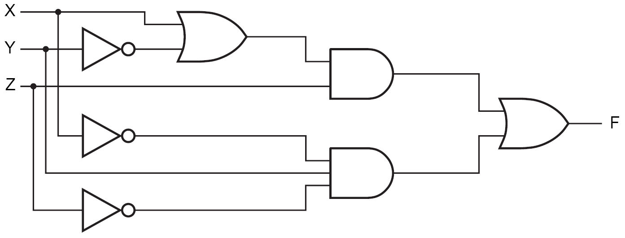
Circuit Analysis
  Circuit to be analyzed:

Slide 80
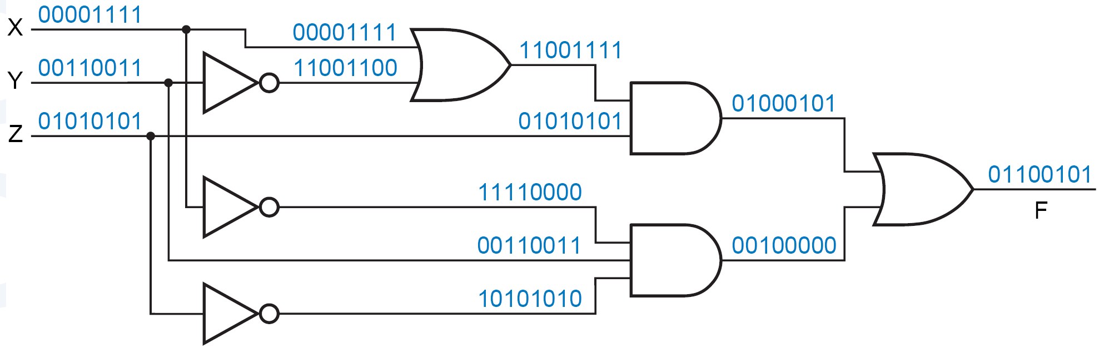
Circuit Analysis
  Circuit to be analyzed:
  Consider all possible combinations of inputs

Slide 81
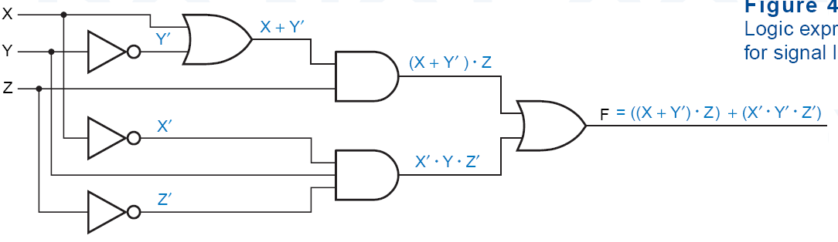
Circuit Analysis
  Circuit to be analyzed:
  Can also name the nodes
N₁ = X+Y’
N₂ = N₁.Z
N₁
N₃ = X’.Y.Z’
N₂
F = N₂+N₃
N₃
F = N₁.Z+ X’.Y.Z’
= (X+Y’). Z+ X’.Y.Z’

Slide 82
Boolean expressions-
NOT unique
x | y | z |  | F | G
0 | 0 | 0 |  | 1 | 1
0 | 0 | 1 |  | 0 | 0
0 | 1 | 0 |  | 1 | 1
0 | 1 | 1 |  | 0 | 0
1 | 0 | 0 |  | 0 | 0
1 | 0 | 1 |  | 0 | 0
1 | 1 | 0 |  | 1 | 1
1 | 1 | 1 |  | 0 | 0
  Unlike truth tables, expressions representing a Boolean function are NOT unique.
  Example:
    F(x,y,z) = x’•y’•z’ + x’•y•z’ + x•y•z’
    G(x,y,z) = x’•y’•z’ + y•z’
  The corresponding truth tables for F() and G() are identical!
  Thus, F() = G()

Slide 83
Complementation: Example
Find the complement of
F(x,y,z) = xy’z’ + x’yz
  G = F’

Slide 84
Complementation: Example
Find the complement of
F(x,y,z) = xy’z’ + x’yz
  G = F’ = (xy’z’ + x’yz)’
  = (xy’z’)’ • (x’yz)’ DeMorgan
  = (x’+y+z) • (x+y’+z’) DeMorgan again
Note:
  Complement of F: dual(F) → complement all literals

Slide 85
Complement of a Function
• ↔ +
1 ↔ 0
X ↔ X’
  Interchange 1s to 0s in the truth table column showing F.
  The complement of a function IS NOT THE SAME as the dual of a function.

Slide 86
De Morgan’s Law for a Complex Expression
Example:
  ((A + B’).C’.D + EF)’
  =

Slide 87
De Morgan’s Law for a Complex Expression
Example:
  ((A + B’).C’.D + EF)’
  = ((A’.B) + C + D’) . (E’ + F’)
Note:
  Don’t change operator precedence

Slide 88
Shannon Theorem
  F(x₁,x₂,…,x_{n}) = x₁.F(1,x₂,…,x_{n}) + x₁’.F(0,x₂,…,x_{n})
  F(x₁,x₂,…,x_{n}) = [x₁ + F(0,x₂,…,x_{n})].[x₁’+ F(1,x₂,…,x_{n})]

Slide 89
Boolean vs. Ordinary Algebra
Some of Boolean Algebra are not true for ordinary algebra
Example:
True in ordinary algebra
Not True in Boolean algebra
Example:
True in ordinary algebra
Not True in Boolean algebra
Some of Boolean Algebra properties are true for ordinary algebra too.
Example:
True in both ordinary and
Boolean algebra

Slide 90
Relationship Among Representations
Theorem:
  Any Boolean function that can be expressed as a truth table can be written as an expression in Boolean Algebra using AND, OR, NOT.
covered
covered
covered
covered
How do we convert from one to the other?
Optimizations?

Slide 91
Ckt (Gate) to Truth Table
  Circuit to be analyzed:
  Consider all possible combinations of inputs

Slide 92
Ckt to Boolean + Boolean to TT
Circuit of logic gates :
Logic Expression :
Logic Evaluation : A=B=C=1, D=E=0

Slide 93
Boolean to Ckt
Combinational Circuit Design:
F = A’ + B•C’ + A’•B’
  connect input signals and logic gates:
    Circuit input signals → from function variables (A, B, C)
    Circuit output signal → function output (F)
    Logic gates → from logic operations
C
A
F
B

Slide 94
Minterms and Maxterms
Minterm:
  a product term in which all the variables appear exactly once, either complemented or uncomplemented
Maxterm:
  a sum term in which ….
  Minterms and Maxterms are easy to denote using a truth table.
x | y | z |  | Minterm | Maxterm
0 | 0 | 0 |  | x’y’z’ = m₀ | x+y+z = M₀
0 | 0 | 1 |  | x’y’z = m₁ | x+y+z’ = M₁
0 | 1 | 0 |  | x’yz’ = m₂ | x+y’+z = M₂
0 | 1 | 1 |  | x’yz = m₃ | x+y’+z’= M₃
1 | 0 | 0 |  | xy’z’ = m₄ | x’+y+z = M₄
1 | 0 | 1 |  | xy’z = m₅ | x’+y+z’ = M₅
1 | 1 | 0 |  | xyz’ = m₆ | x’+y’+z = M₆
1 | 1 | 1 |  | xyz = m₇ | x’+y’+z’ = M₇
Observe that: m_{j} = M_{j}’

Slide 95
Canonical Forms: Unique
  Any Boolean function F( ) can be expressed as a unique sum of minterms (and a unique product of maxterms)
  In other words, every function F() has two canonical forms:
    Canonical Sum-Of-Products (sum of minterms)
    Canonical Product-Of-Sums (product of maxterms)

Slide 96
Canonical Forms (cont.)
Canonical Sum-Of-Products:
  The minterms included are those m_{j}’s such that F( ) = 1 in row j of the truth table for F( ).
Canonical Product-Of-Sums:
  The maxterms included are those M_{j}’s such that F( ) = 0 in row j of the truth table for F( ).

Slide 97
Example
a | b | c |  | f₁
0 | 0 | 0 | 0 | 0
0 | 0 | 1 | 1 | 1
0 | 1 | 0 | 2 | 1
0 | 1 | 1 | 3 | 0
1 | 0 | 0 | 4 | 1
1 | 0 | 1 | 5 | 0
1 | 1 | 0 | 6 | 1
1 | 1 | 1 | 7 | 0
  f₁(a,b,c) = m₁ + m₂ + m₄ + m₆
  = a’b’c + a’bc’ + ab’c’ + abc’
  f₁(a,b,c) = M₀ • M₃ • M₅ • M₇
  = (a+b+c)•(a+b’+c’)• (a’+b+c’)•(a’+b’+c’).

Slide 98
Shorthand: ∑ and ∏
f₁(a,b,c) = ∑ m(1,2,4,6),
  m₁+ m₂ + m₄ + m₆.
f₁(a,b,c) = ∏ M(0,3,5,7),
  M₀ . M₃ . M₅ . M₇.

Slide 99
Conversion Between Canonical Forms
  Replace ∑ with ∏ (or vice versa)
  Replace those j’s that appeared in the original form with those that do not.
Example:
  f₁(a,b,c) = a’b’c + a’bc’ + ab’c’ + abc’
  = m₁ + m₂ + m₄ + m₆
  = ∑(1,2,4,6)
  = ∏(0,3,5,7)
  = (a+b+c)•(a+b’+c’)•(a’+b+c’)•(a’+b’+c’)

Slide 100
Standard Forms (NOT Unique)
  Standard forms are “like” canonical forms,
    Not all variables need appear in the individual product (SOP) or sum (POS) terms.
Example:
  f₁(a,b,c) = a’b’c + bc’ + ac’
  is a standard sum-of-products form
  f₁(a,b,c) = (a+b+c)•(b’+c’)•(a’+c’)
  is a standard product-of-sums form.

Slide 101
Alternative Implementations
A
F(A,B,C) = Σm(3,4,5,6,7)
F = A' B C + A B' C' + A B' C + A B C' + A B C
B
Canonical Sum of Products
F
C
1
Minimized Sum of Products
A + B C
F
2
Canonical Products of Sums
F
3
F(A,B,C) = ΠM(0,1,2)
= (A + B + C) (A + B + C') (A + B' + C)

Slide 102
Conversion of SOP from standard to canonical
  Expand non-canonical terms by inserting equivalent of 1 in each missing variable
    x: (x + x’) = 1
  Remove duplicate minterms
  f₁(a,b,c) = a’b’c + bc’ + ac’
  = a’b’c + (a+a’)bc’ + a(b+b’)c’
  = a’b’c + abc’ + a’bc’ + abc’ + ab’c’
  = a’b’c + abc’ + a’bc + ab’c’

Slide 103
Conversion of POS from standard to canonical
  Expand noncanonical terms by adding 0 in terms of missing variables (e.g., xx’ = 0) and using the distributive law
  Remove duplicate maxterms
  f₁(a,b,c) = (a+b+c)•(b’+c’)•(a’+c’)
  = (a+b+c)•(aa’+b’+c’)•(a’+bb’+c’)
  = (a+b+c)•(a+b’+c’)•(a’+b’+c’)•
  (a’+b+c’)•(a’+b’+c’)
  = (a+b+c)•(a+b’+c’)•(a’+b’+c’)•(a’+b+c’)

Slide 104
More Logic Gates
NAND:
  NOT-AND
    Its output = 1, only if both inputs are not 1.
    (A • B)’
  has traditionally been the universal gate in digital circuits.
    It is simple to implement in hardware and can be used to construct the other gates.
A | B | (A.B)’
0 | 0 | 1
0 | 1 | 1
1 | 0 | 1
1 | 1 | 0

Slide 105
More Logic Gates
NOR:
  NOT-OR
    Its output = 1, only if no input is 1.
    (A + B)’
  Can be a universal gate.
A | B | (A+B)’
0 | 0 | 1
0 | 1 | 0
1 | 0 | 0
1 | 1 | 0

Slide 106
More Logic Gates
XOR:
  Inequality
    Its output = 1, only if exactly one input is 1.
    (A ⊕ B)
A | B | A XOR B
0 | 0 | 0
0 | 1 | 1
1 | 0 | 1
1 | 1 | 0
(A ⊕ B) = A.B’ + A’.B

Slide 107
More Logic Gates
3-input XOR:
    Its output = 1, only if one or three inputs are 1.
    (A ⊕ B ⊕ C)
A | B | C | A XOR B XOR C
0 | 0 | 0 | 0
0 | 0 | 1 | 1
0 | 1 | 0 | 1
0 | 1 | 1 | 0
1 | 0 | 0 | 1
1 | 0 | 1 | 0
1 | 1 | 0 | 0
1 | 1 | 1 | 1

Slide 108
More Logic Gates
XNOR:
  Equality
    Its output = 1, only both inputs are equal.
    (A ⊕ B)’
A | B | A XNOR B
0 | 0 | 1
0 | 1 | 0
1 | 0 | 0
1 | 1 | 1
(A ⊕ B)’ = A.B + A’.B’

Slide 109
Theorems for XOR

Slide 110
Problem Solving
  More often, we describe a logic function using the English-language connectives “and,” “or,” and “not.”
Example: CE Lift
  The MOVE output is 1 if
    a button in a floor (OUTSIDEB) is 1, and OPENB button is 0 and door lift is closed (CLOSED = 1)
    or a button inside the lift (INSIDEB) is 1 and door lift is closed (CLOSED = 1)
  OUTSIDEB is 1 if
    OUTBUTTON1 is 1 or OUTBUTTON2 is 1 or OUTBUTTON3 is 1
  INSIDEB is 1 if
    KEY1 is 1 or KEY2 is 1 or KEY3 is 1

Slide 111
Problem Solving
  Sometimes we have to work with imprecise word descriptions of logic functions,
Example:
  “The ERROR output should be 1 if the GEAR, CLUTCH, and BRAKE inputs are inconsistent.”
  Truth-table approach is best
    It allows us to determine the output required for every input combination, based on our knowledge and understanding of the problem environment
    e.g., the gear cannot be applied unless the clutch is pressed.

Slide 112
Example
A 4-bit Prime Number Detector
F = Σ_{N3,N2,N1,N0}(1, 2, 3, 5, 7, 11, 13)
=N3′.N2′.N1′.N0 + N3′.N2′.N1.N0′ + N3′.N2′.N1.N0+ N3′.N2.N1′.N0 + N3′.N2.N1.N0 + N3.N2′.N1.N0 + N3.N2.N1′.N0
N3′.N1′.N0 + N3′.N2′.N1 + N3′.N2.N1.N0 + N3.N2′.N1.N0 + N3.N2.N1′.N0
…
براي عبارات پيچيده، کار بهينه سازي سخت تر ميشود.
روشي سيستماتيک و آسان تر: نقشة کارنو
  شما را از جبر بول بي نياز نمي کند.

Slide 113

7-Segment Decoder
Seven-segment display:
  7 LEDs (light emitting diodes), each one controlled by an input
  1 means “on”, 0 means “off”
  Display digit “3”?
    Set a, b, c, d, g to 1
    Set e, f to 0
a
f
b
g
e
c
d

Slide 114
7-Segment Decoder
C
0
C
C
5
C
6
1
C
C
4
2
C
3
C
C
C
C
C
C
C
0
1
2
3
4
5
6
4-bit Binary-to-7-segment
control signal
decoder
A
B
C
D

Slide 115
7-Segment Decoder
7-Segment Decoder:
  Input is a 4-bit binary code → 4 inputs (A, B, C, D).
  Output is a 7-bit code (a,b,c,d,e,f,g) that allows for the decimal equivalent to be displayed.
Example:
  Input: 0000
  Output: 1111110
  (a=b=c=d=e=f=1, g=0)
a
f
b
g
e
c
d

Slide 116
Binary-to-7Segment Truth Table
Digit
ABCD
abcdefg
Digit
ABCD
abcdefg
0
0000
1111110
8
1000
1111111
1
0001
0110000
9
1001
111X011
1010
XXXXXXX
2
0010
1101101
1011
XXXXXXX
3
0011
1111001
1100
XXXXXXX
4
0100
0110011
1101
XXXXXXX
5
0101
1011011
1110
XXXXXXX
6
0110
X011111
1111
XXXXXXX
7
0111
11100X0
??

Slide 117
Binary-to-7Segment Truth Table
Digit
ABCD
abcdefg
Digit
ABCD
abcdefg
0
0000
1111110
8
1000
1111111
9
1001
1110011
1
0001
0110000
1010
XXXXXXX
2
0010
1101101
1011
XXXXXXX
3
0011
1111001
1100
XXXXXXX
4
0100
0110011
1101
XXXXXXX
5
0101
1011011
1110
XXXXXXX
6
0110
1011111
1111
XXXXXXX
7
0111
1110000
??

Slide 118
Incompletely Specified Functions
Don’t Care:
  We don’t care about the output values for some intput patterns.
  this fact can be exploited during circuit minimization!
Example:
  BCD incrementer:
Off-set of W
On-set of W
Don't care (DC) set of W
These input patterns should
never be encountered in practice
associated output values are
"Don't Cares"

Slide 119
Don't Cares and Canonical Forms
Canonical Representations of the BCD Incrementer:
Z = m0 + m2 + m4 + m6 + m8 + d10 + d11 + d12 + d13 + d14 + d15
Z = Σm(0, 2, 4, 6, 8) + d(10, 11, 12 ,13, 14, 15)
Z = M1 • M3 • M5 • M7 • M9 • D10 • D11 • D12 • D13 • D14 • D15
Z= ΠM(1, 3, 5, 7, 9) • D(10, 11, 12, 13, 14 ,15)

